Slide 1
How to copy a picture from a PDF publication and store it in the folder Pictures of the World Database of Happiness
In this presentation I use a picture taken from a 2018 publication of
Piet Ouweneel
In the second part of he presentation I show you how to add pictures to a study in the corrolational findings

Slide 2
In this presentation it is assumed you are familiar with the World Datebase of Happiness if not Please contact Jos Richters Email: j.Richters@hccnet.nl

Slide 3
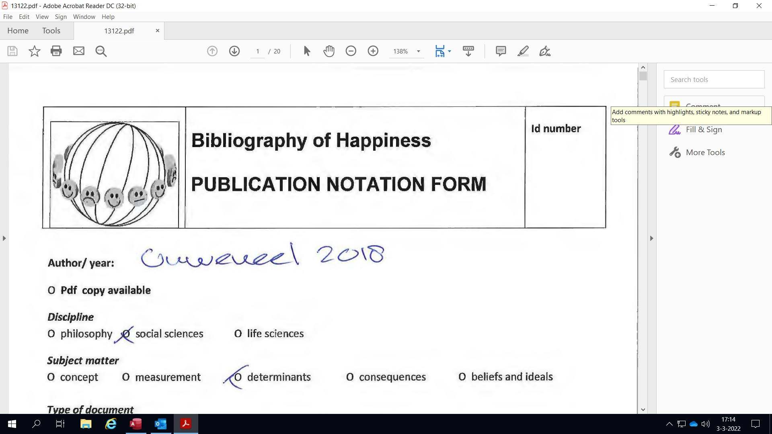
The PDF will open with the Notification Form of the publication
Scroll to the relevant picture

Slide 4
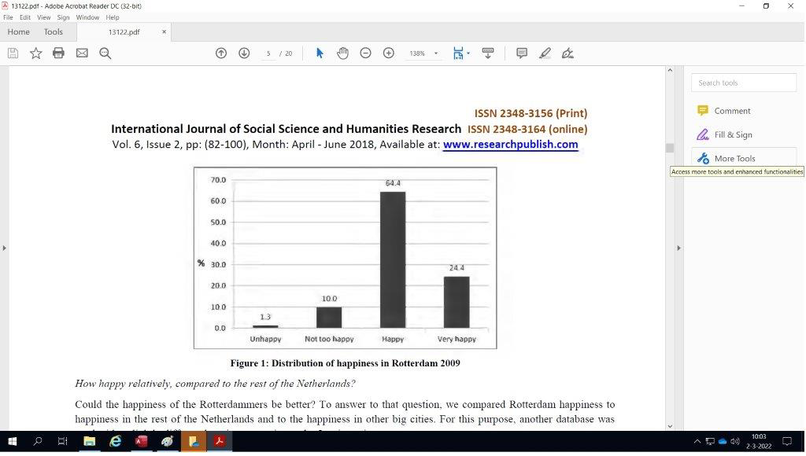
Go to the picture you wish to copy
For copying click on the “Edit” menu

Slide 5
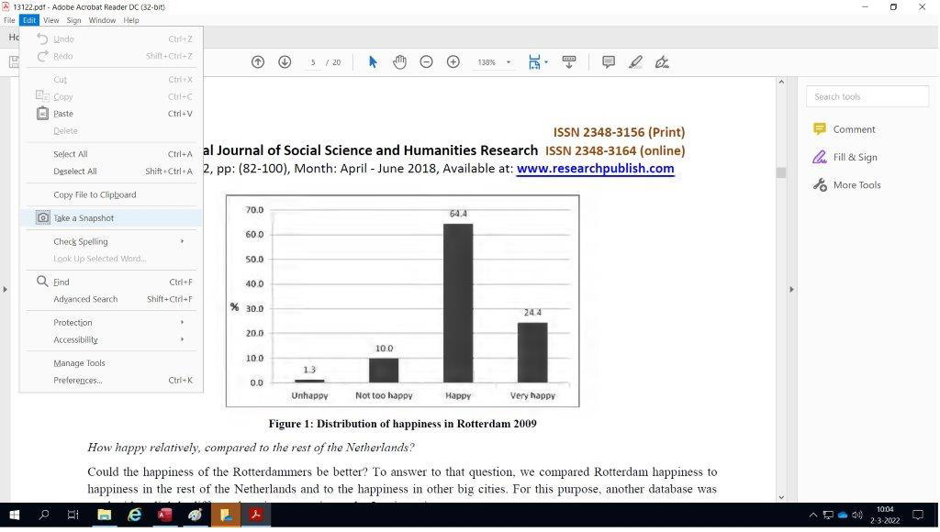
Click on “Take a Snapshot”

Slide 6
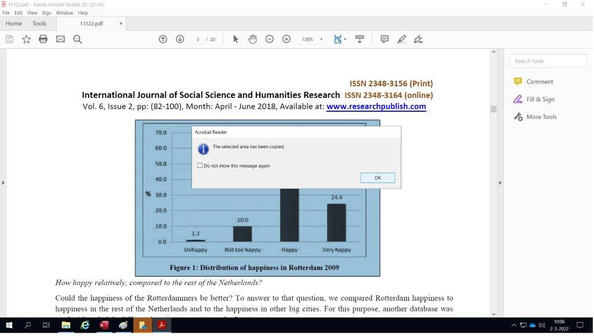
Make a selection and copy the picture
Using the cursor select the picture you wish to copy. To do so, click on the picture's left top corner, hoover over the picture and while pressing the left mouse button go to the right bottom corner of the picture including the pictures name. Release the left mouse button. A pop-up widow will appear to indicate the picture has been copied. To finish click on “OK".

Slide 7
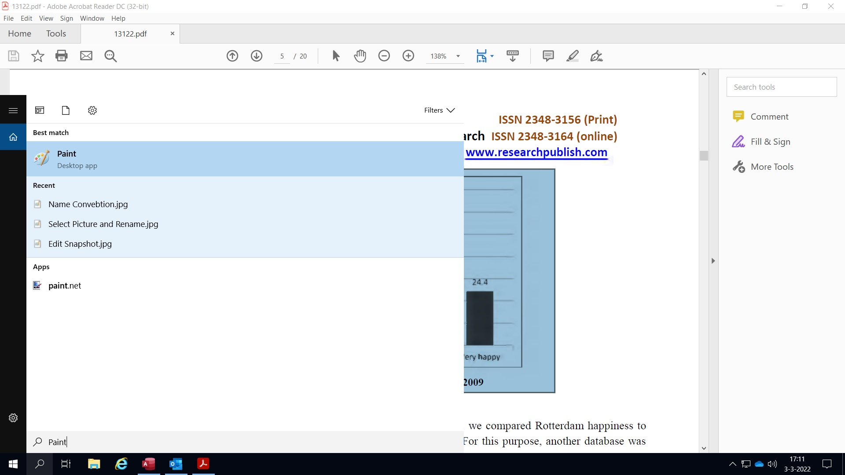
To save the copy use the App Paint
Go to the left bottom corner of the screen and click in the field with magnifier glass and type Paint
Click on paint to open the App

Slide 8
Paste the copy of the picture into paint
Go to the menu “Paste” and select “Paste”. The picture will appear as shown.
If the white area around the picture is bigger then the picture, then make the white size equal to the picture size. Click in the white area, go with the cursor to the right bottom corner of the white area, where you see a very small square dot. Click with the left mouse button in the on that dot. The cursor will change into a dubbel arrow under 45 degrees. Then while pressing the left mouse button move towards the left bottom corner of the picture and release the mouse button and the white area size equals the picture’s size.

Slide 9
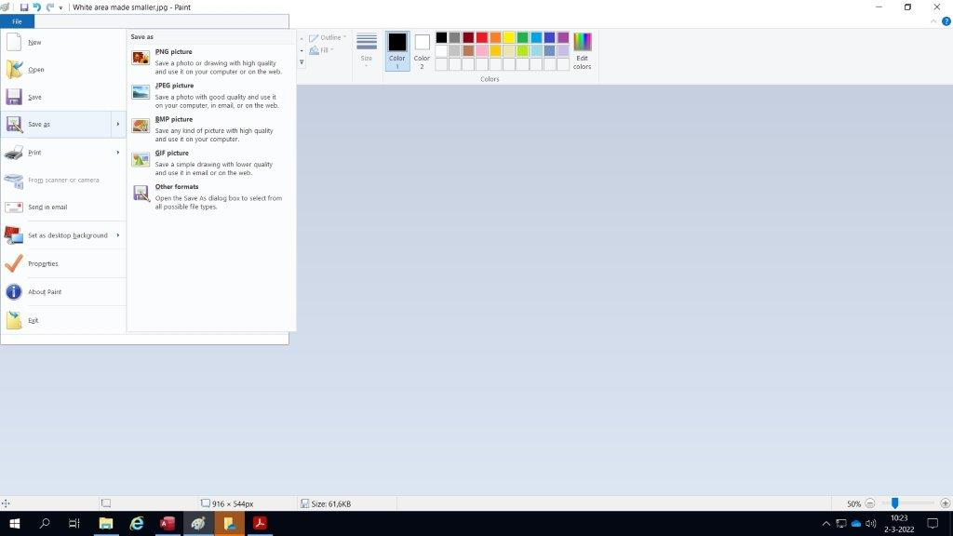
Click on "File"menu and select "Save as"

Slide 10
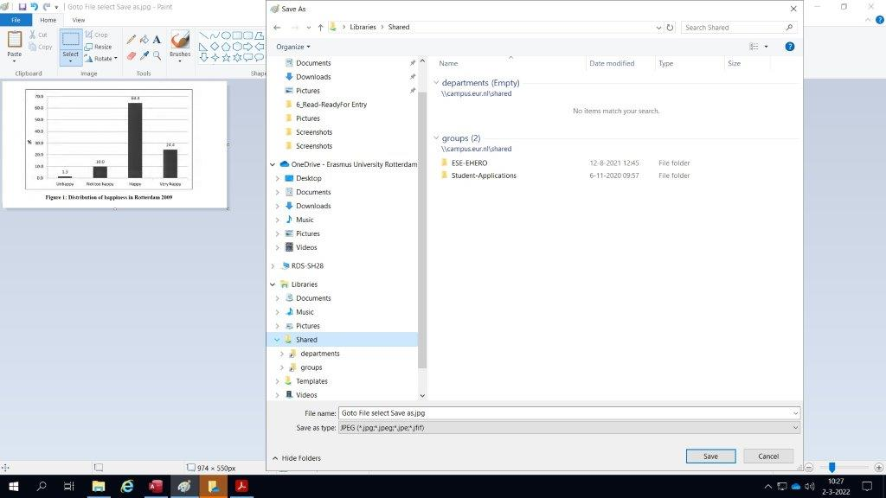
Go to the folder "Libraries“ and to the Folder "Shared"
Libraries
Share

Slide 11
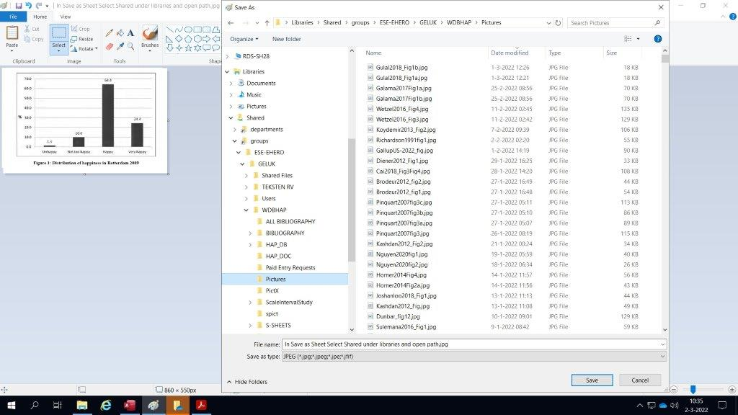
Go to the folder “Pictures” of the WDBHAP and follow the path as shown
The path to “Pictures”in de WDBHAP is: Libraries>Shared>groups>ESE-EHERO>Geluk>WDBHAP>Pictures

Slide 12
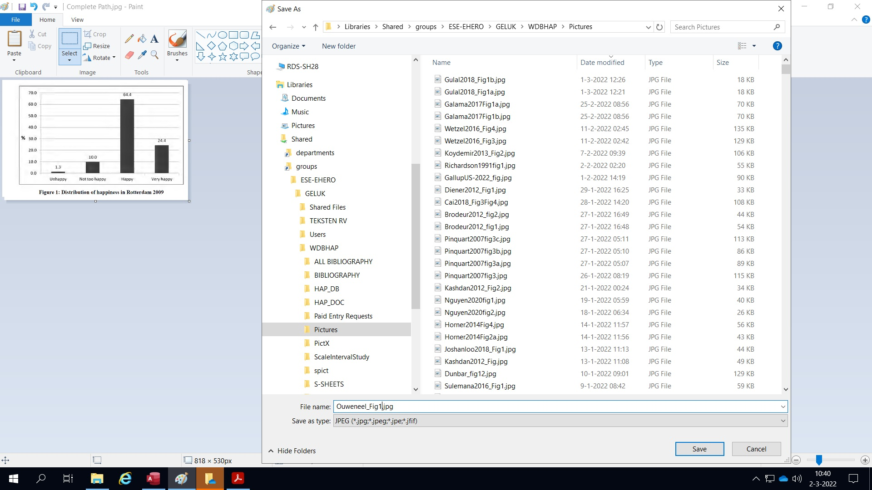
Give the Picture a name and save it
The file extension must be .jpg
In the field "Save as type" select jpg
The name convention is written as follows: Author's name followed by Year of publication underscore Fig number
Example: Ouweneel2018_Fig1.jpg

Slide 13
The picture is now saved in the Folder "Pictures" of the World Database of Happiness (WDBHAP)
Note:
It is important that the path of the folder "Pictures" should be followed accurately as was shown in the demonstration, do not store the copy in a different folder named Pictures
We will now continue the presentation to demonstrate how to add a picture to a study in the Corrolational Findings

Slide 14
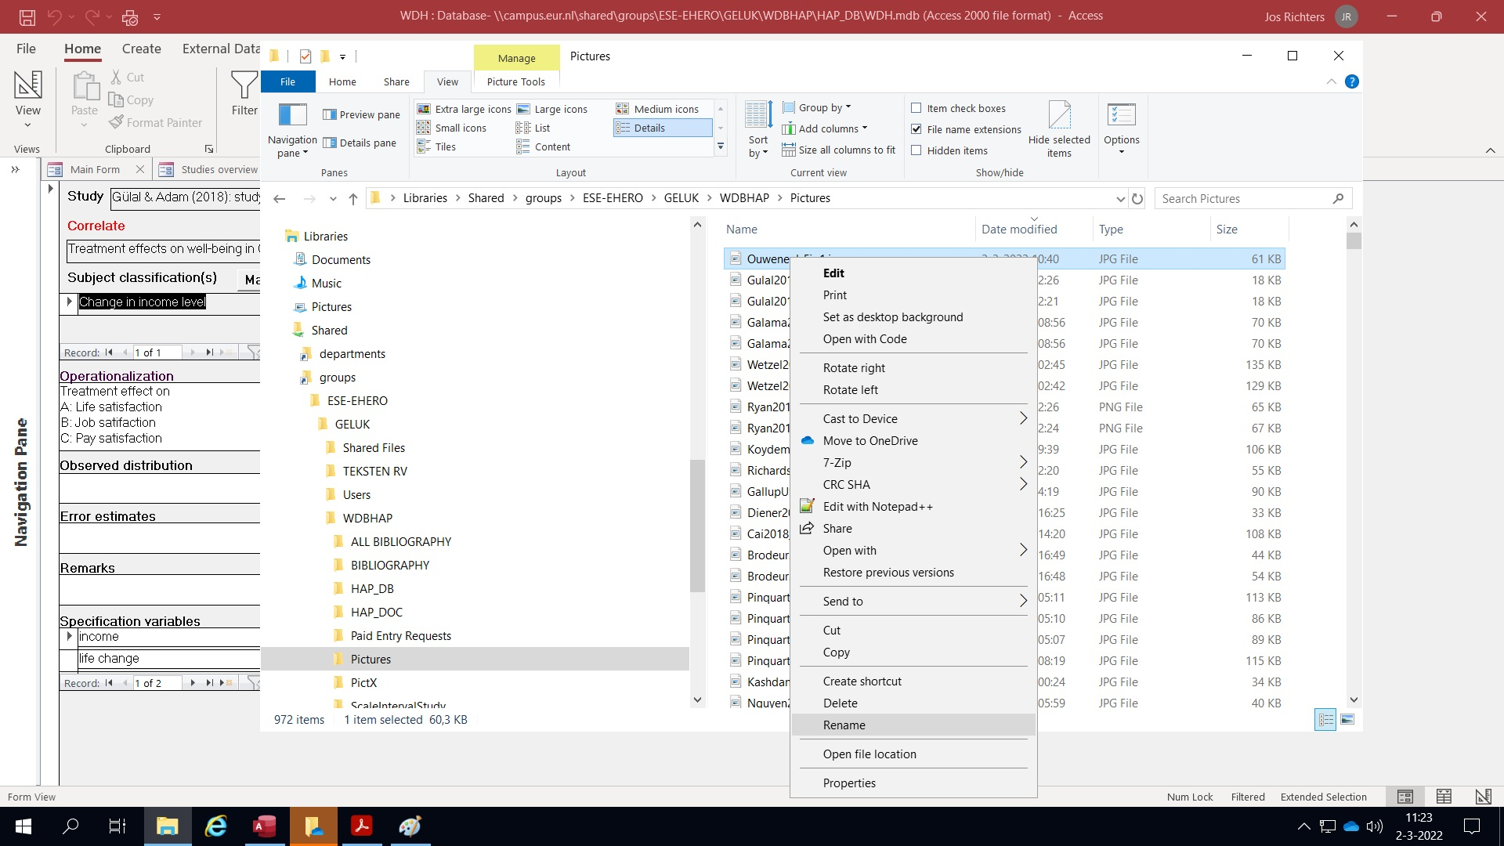
First copy the name of the Picture
Go to the Folder "Pictures“ in the folder `WDBHAB` as explained before. To copy the name of the relevant picture select and copy the name: right click on the picture's name, select rename, make the full name blue including the .jpg. Now right click and select copy. Do not change the name of the picture only copy. Note: you will later paste the name in the study you are working on

Slide 15
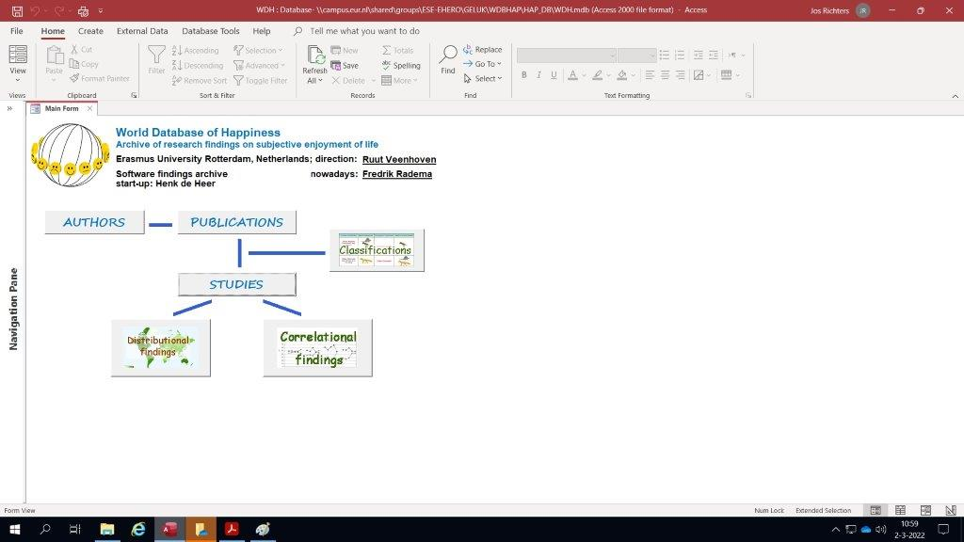
Now go to the Main form of the World Database of Happiness
To select your study click on the "Studies"

Slide 16
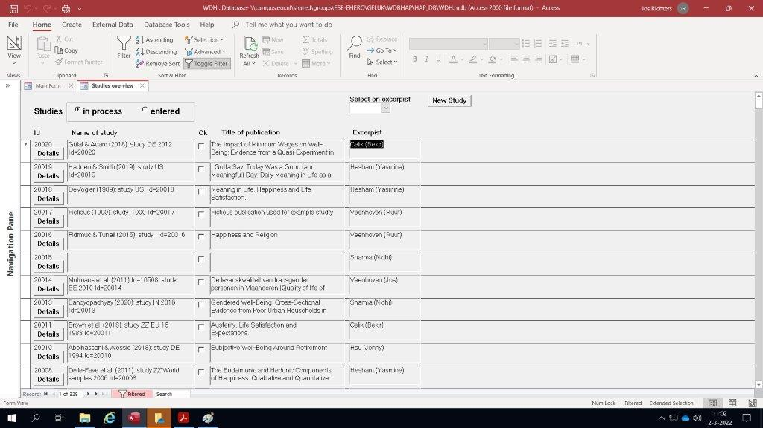
Now select the relevant study
Select your study.
As an example I go to the first study of the list and click on the button "Details"

Slide 17
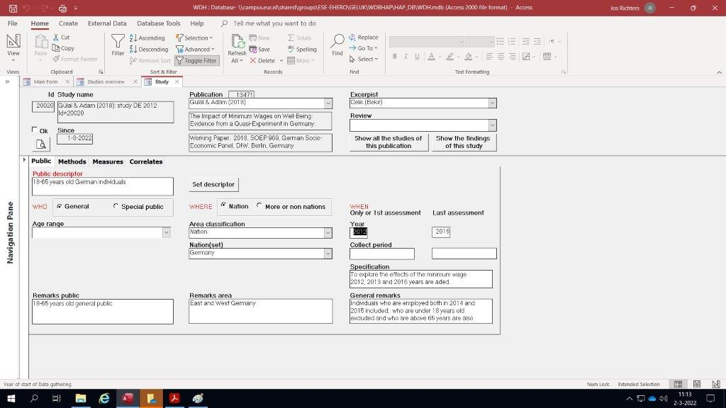
Looking at the details form of the study select the Findings
Click on the Butten
"Show the Findings of the Study"
to go to the Correlational Findings

Slide 18
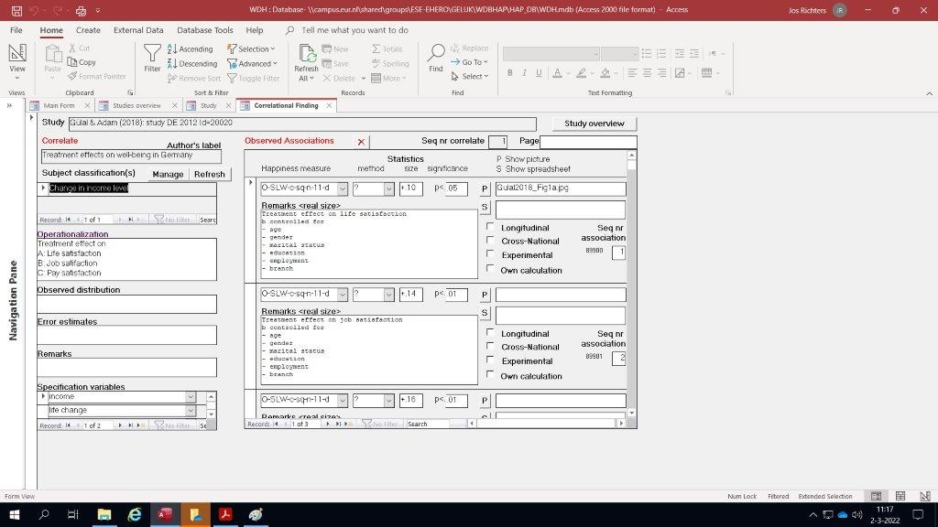
Add the picture to the Corrolational Findings
To add the picture to your study paste the exact picture's name as you copied in the P field
Note:
this Corrolational finding already contains a picture which belongs to a certain Happiness Measure.
Additional pictures should be entered to the Happiness measures they belong to

Slide 19
If you have any question, need support and/or have remarks on this presentation please contact me
My name is: Jos Richters
Email address: j.richters@hccnet.nl

